Slide 1

CSC 405
Final
Presentation
4Leaf Co.

Slide 2
HELLO!
We are 4Leaf Co.
Jordan Quick → Project Manager (PM)
Frances Coronel → 2nd in Command
Calvin Chambers → Writer/Lead Developer
Anesha Passalacqua → Writer/Developer
4Leaf Co.

Slide 3

AGENDA
The Problem
The Solution
Tasks
Features
Lessons Learned
Demo
Future Development

Slide 4
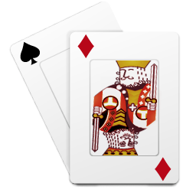
THE PROBLEM
What challenge were we asked to solve?

Slide 5
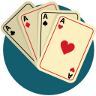


As a team we were assigned to complete 3 key components…
Database of Hands
Probability Tables
Blackjack Game

Slide 6

THE SOLUTION
Method Implementation
Languages

Slide 7
Frequency Table
Called in card databases from MySQL to run simulations of blackjack games in Eclipse using Java
Strategy Card
Program that evaluates each simulation and outputs the best player move
Console Game
Teaches user how to play blackjack through text-based game
METHOD IMPLEMENTATION

Slide 8
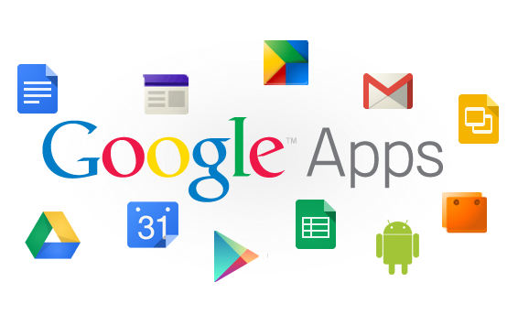

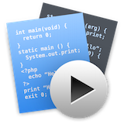



TOOLS USED

Slide 9

TASKS
Member Assignments
Requirements

Slide 10
Frances Coronel
Manual probability calculations chart
Format documentation, timesheets, minute meetings
Console game, strategy method program
Design & Functional documentation

Slide 11
Anesha Passalacqua
Create manual probability calculations chart
Formatted documentation, timesheets, minute meetings
Console game

Slide 12
Calvin Chambers
Formulated probability program and Strategy Table
Formulated Frequency Table Program
Formatted documentation, timesheets, minute meetings
Console game

Slide 13
Jordan Quick
Create manual probability calculations chart
Formatted documentation, timesheets, minute meetings
Console game
Assisted with all programs assigned to team

Slide 14

FEATURES
Overview of components

Slide 15

Database
Program
Provides card constants for the Frequency Table and Probability Statistics Program
Provides various deck sizes for the programs. Deck Sizes available are 1, 2, 4, 6, and 8.
Uses SQL Code to connect to 4 Leaf Co created programs.

Slide 16
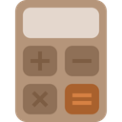
Frequency
Program
Formulates a frequency table to show the odds of a number of occurrence for each possible hand derived from the database for a million hands.
Connects to the database to receive the constants used to implement the randomized hands.
Formulates a frequency table for (n) number of deck sizes.

Slide 17
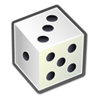
Probability
Program
Formulates a strategy table giving the probability of winning after each hand combination.
Formulates methods conducted by the selected moves (Split, Double Down, Hit or Stand).
Creates a strategy card to advise gameplay conducted in the console game.

Slide 18

Console Game
Gives player hint depending on input of strategy card text file
Player has four potential moves they can make:
Split
Double Down
Hit
Stand
Score tracking

Slide 19

LESSONS
LEARNED
Mistakes Made
Challenges Faced

Slide 20

Mistakes Made
Time Management
Jordan scheduling meetings
Open Communication
Calvin feeling stressed out
External Circumstances
Frances traveling
Anesha commuting from North Carolina at the beginning of the semester

Slide 21
Frances Coronel
Communicate all issues you’re having with your teammates, even if they seem small or arbitrary
Verify documents before turning them in
Client makes the rules, not you
Place priority on the client project before anything else

Slide 22
Calvin Chambers
To have better Time Management Skills
To be more organized with Documentation and Code
To have better Communication with Team Members on Issues
To be more precise with the development of deliverables
To not try to do all the work myself and work more as a team.

Slide 23
Anesha Passalacqua
Communication- Asking for help when needed
Time management

Slide 24
Jordan Quick
Time management
Better decision making skills
How to be more stern
Being a fair leader
Organizational skills

Slide 25
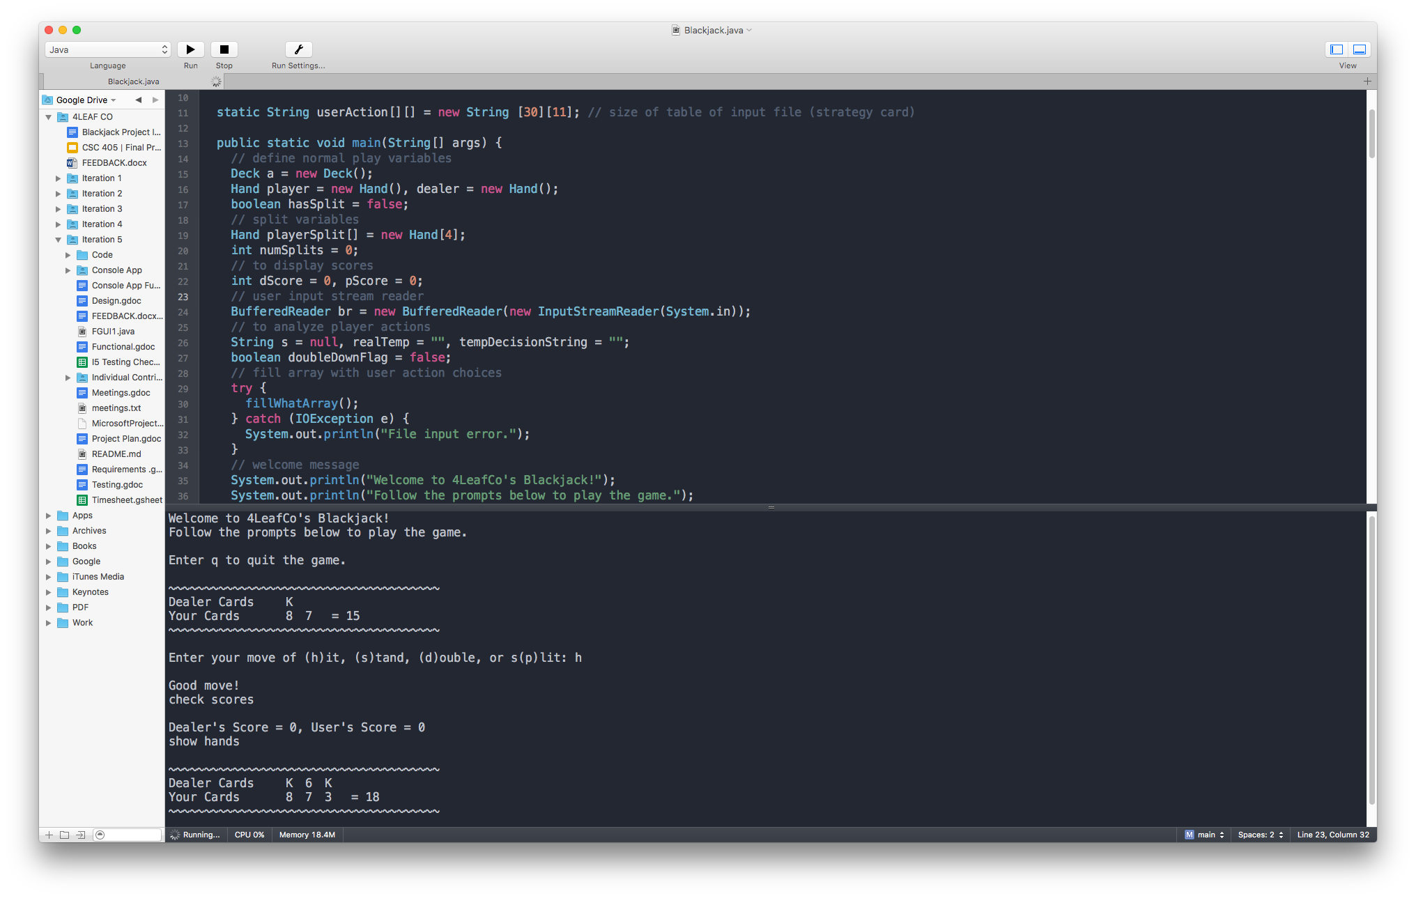
DEMO TIME
Now we’re going to play a game of blackjack through our desktop game which was built using Java, so it can run on any platform.

Slide 26

FUTURE DEVELOPMENT
Features to add
Concluding remarks

Slide 27
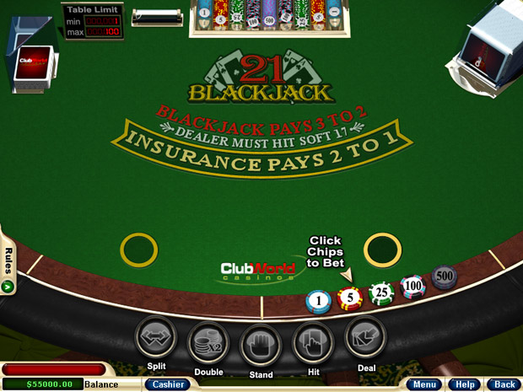
Optimize Console Game
Implement GUI - Deploy to an actual cross platform desktop app
Betting - Players can actually win virtual money/points
Customization - Player can customize game (deck size, surrender option, double after split, etc.)

Slide 28
Concluding Remarks
We came together as a team to accomplish our tasks despite the many challenges we faced.

Slide 29

THANKS
Any questions, comments, or concerns?

